Slide 1
Connected Device Studio Onboarding Training
Kevin Kao
kevika@microsoft.com
Senior Program Manager
Microsoft IoT Innovation Center

Slide 2
Objectives and takeaways
Understand what is the Connected Device Studio: missions, position and benefits
Has ability connecting your equipment and machines to the Connected Device Studio or assist your clients do so.
Know how to setup widgets, dashboards, alarms, and define external applications on the Connected Device Studio, especially by your business context.

Slide 3
Agenda
Industry 4.0 and Factory 09:30 ~ 09:45
Core Concept 09:45 ~ 10:00
Connected Device Studio (A) 10:00 ~ 11:30
Login and User Interface (break 10 min)
Basic Management
Connected Device Studio (B) 11:30 ~ 12:20
Device SDK and HOL
Connected Device Studio (C) 13:30 ~ 16:30
Dashboard and Widget
Alarm and Action (break 20 min)
Operation

Slide 4
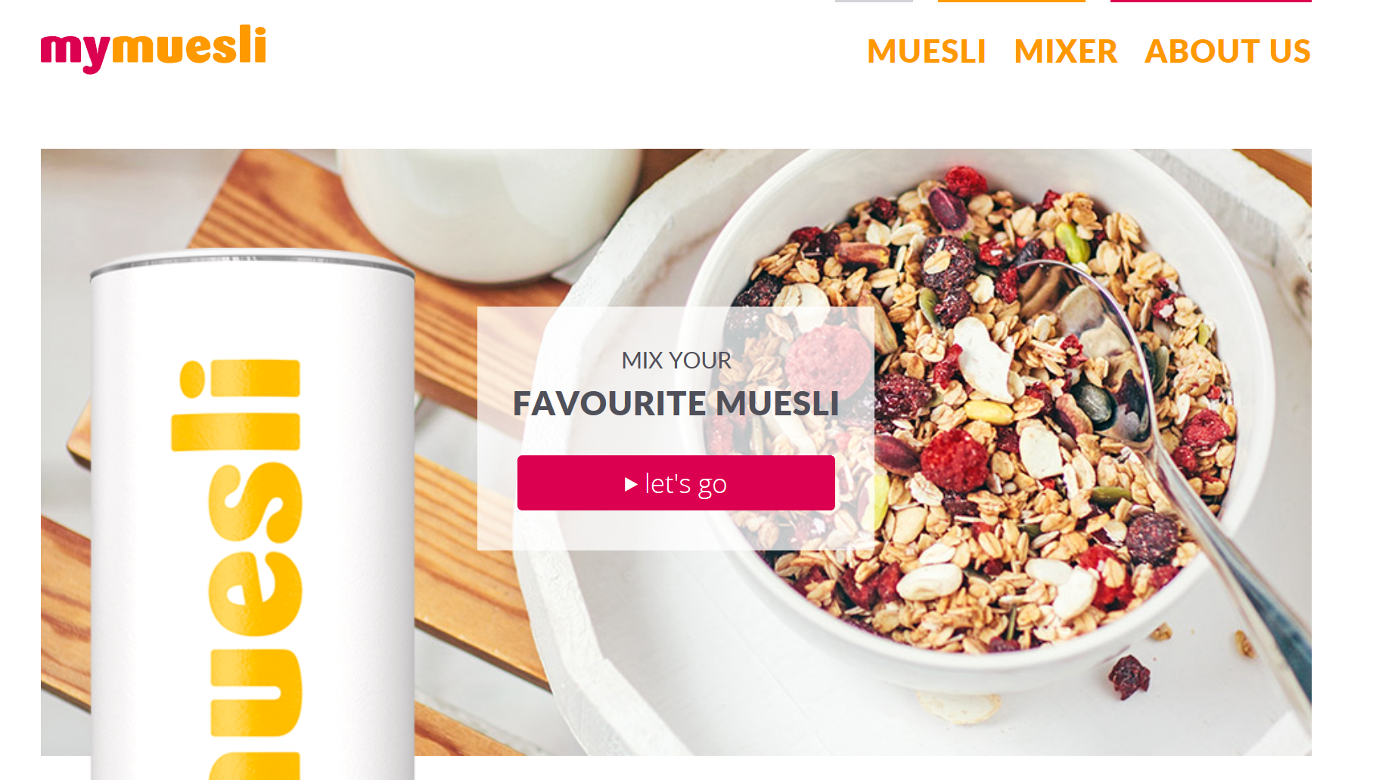

Slide 5


Industry 4.0 – Connected Factory and Customer
Connected Business Network
Connected Customer
Connected Device
Realize new manufacturing flow and service model
Customer insight Factory as a Service
Proactive and predative maintenance
Service oriented organization
New grows by digital transformation
5

Slide 6
Industry 4.0 – Manufacture
Plug-and-Play Factory
Real-time Product & Parts Tracking
Predictive Maintenance
On-demand Assistance (based on AR/VR)
Automated Parts Ordering & Delivery
Embedded Digital Product Memory
„Factory as a Service“
Parts-controlled Production Process
Self-optimizing Production
Human-Robot Collaboration
Seamless Integration of Planning & Production
Seamless Supply & Value Chain Integration
Cyber-Physical Systems (CPS)
Autonomous Robots
Intelligent Products
Additive Manufacturing
Big Data & Analytics / ML
Augmented Reality
Mobile Devices/Apps
Man – Machine – Material - Method
Connectivity & Internet of Things & Cloud

Slide 7


Smart Factory
Event Processing
Storage
Business Insights
Big Data
Analytics
People-centric
Sensors
& Equipment
Devices
& NUI
Device Connectivity & Management | Data management & Insights | Advanced Analytics | Business Productivity & Process Optimization
Gain visibility, access and control to machinery and processes | Manage KPIs to improve operational performance and decision making | Anticipate problems and deliver new value added services | Integrate People and Business Processes

Slide 8
Smart Factory Steps
2. Equip Connectivity, Management, Data Ingestion
3. Data Integration, Visualization, Alarm Management
4. Big Data and Predative Maintenance
1. Factory Automatic, Digitalize
OT
IT

Slide 9
Agenda
Industry 4.0 and Factory 09:30 ~ 09:45
Core Concept 09:45 ~ 10:00
Connected Device Studio (A) 10:00 ~ 11:30
Login and User Interface (break 10 min)
Basic Management
Connected Device Studio (B) 11:30 ~ 12:20
Device SDK and HOL
Connected Device Studio (C) 13:30 ~ 16:30
Dashboard and Widget
Alarm and Action (break 20 min)
Operation

Slide 10
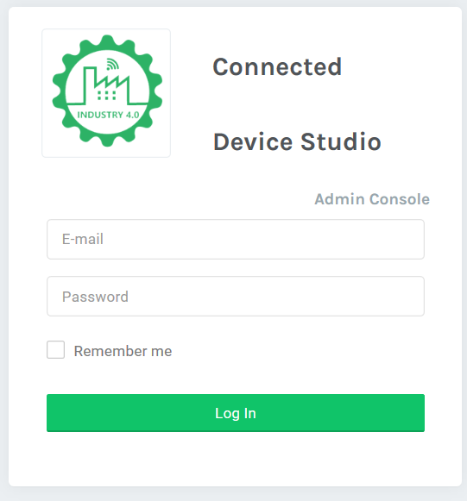
Connected Device Studio Missions
Speed up Industry IoT end to end application development and deployment.
Reduce development effort on Industry IoT application by configurable and manageable approach
Support device deployment from global multiple factories with centralize management
As a SaaS application, offers out of box widget, dashboard, and support customized integration.
admin.iot-cds.net

Slide 11

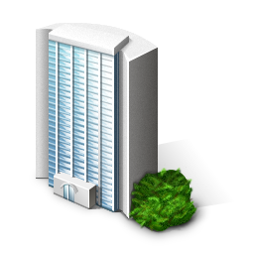

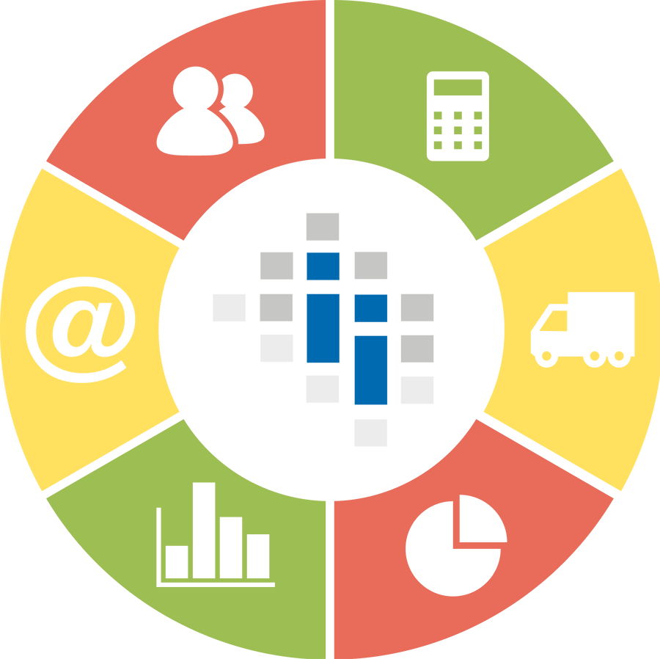





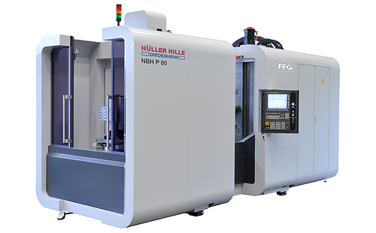
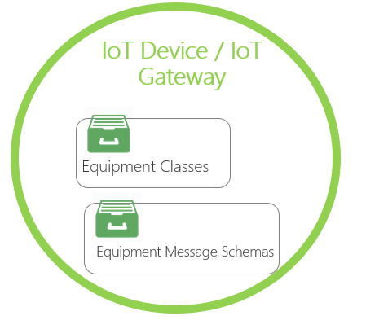



Connected Device Studio
Physical
Cyber
App
Enterprise
V-Enterprise
ERP
V-Factory
Data Platform
Factory
MES
Dashboard,
Monitoring
& Control
Factory Ops
Equipment
IoT Device / Gateway
V-Equipment

Slide 12
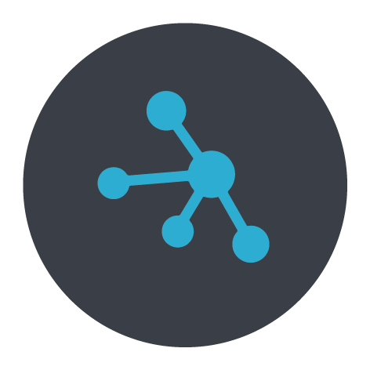




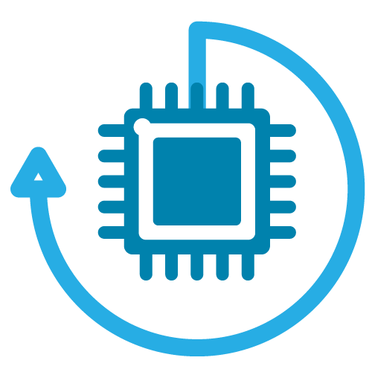


Components
V-Factory
MES/ERP
V-Equipment
Device Mgt
Connected
Device
Studio
Alarm Action
IoT Hub
Certificate
Roles / Users
Alarm Rule
IoT Device
Monitoring
Studio Device SDK
Message Schema

Slide 13





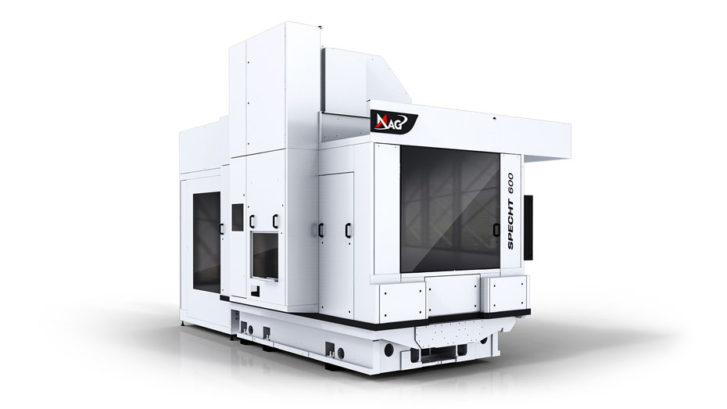
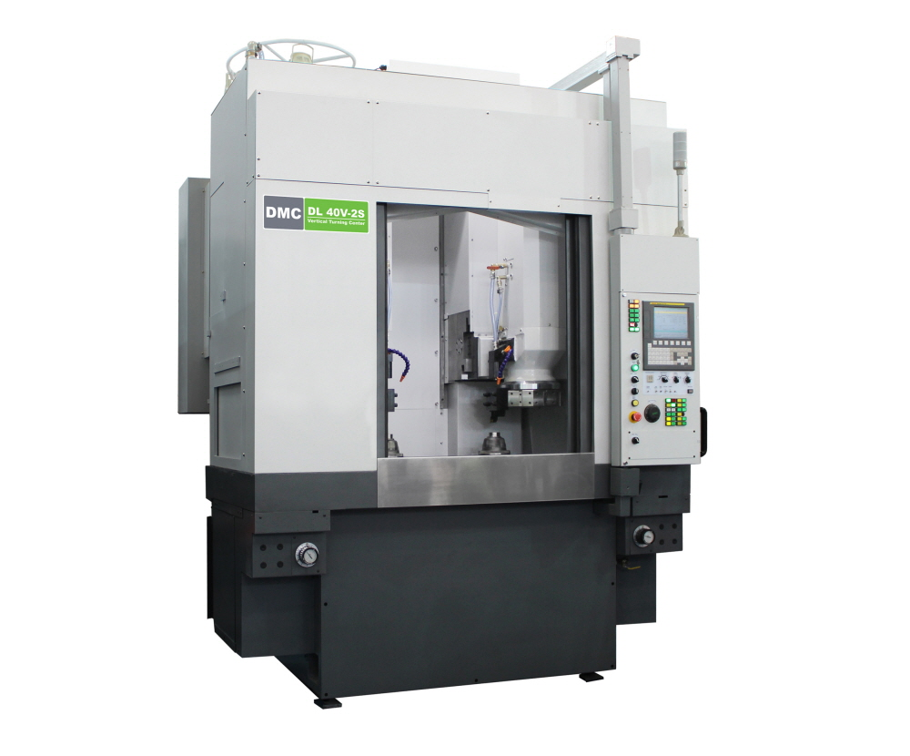
Business Entities
…
Role-based Access Control
Administrator
Factory Ops
Business Manager
Data Engineer
Geographically distinct factories
International Localization
…
Company
Factory A1
Factory S8
Factory FX
Example Equipment
Machine Tools
Inspection Machines
Facility Machines
3D Printers
…
Equipment 01
Equipment 02
Equipment NN

Slide 14

IoT Device
IoT Device / IoT Gateway
Equipment 01
Equipment Classes
Equipment 02
…
Message Schemas
Hybrid Cloud
Multi-tenant SaaS Platform
Open Source
Extendable
Abstract Equipment Message Schema
Dynamic Binding Equipment Data
On the Air Message Schema Validation
Equipment NN

Slide 15
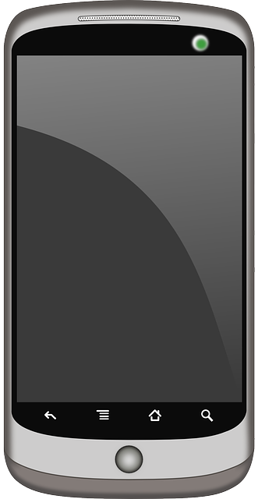

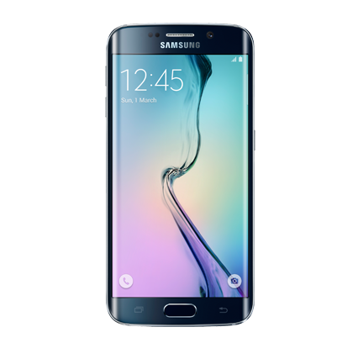
Mobile Phone Inspection
10:00 AM
Inspection Flow
Inspection Parameters
Expected Quality Value
Inspection Result Schema
Inspection Machine
02:00 PM

Slide 16
Connected Device Studio Device SDK
Simplify equipment connectivity in a secure and efficient manner.
Target to 99.99% SLA from device to cloud
Automatic failover procedure
Message schemas verified and validated
Configuration Management

Slide 17
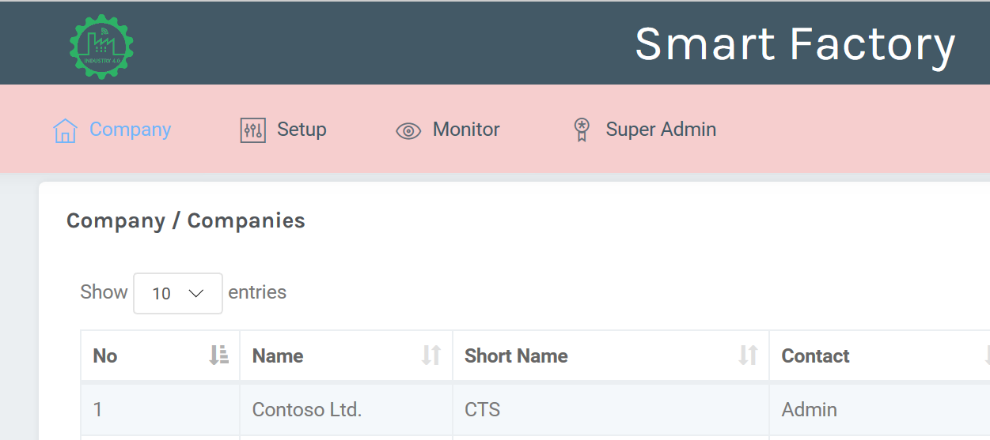


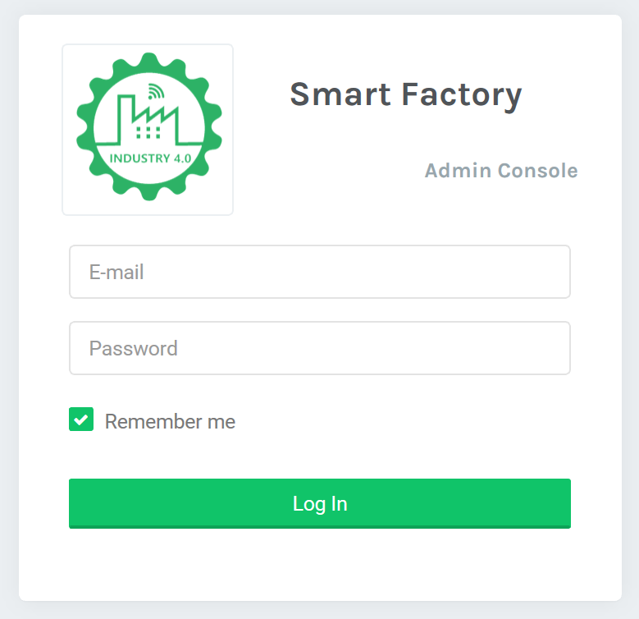
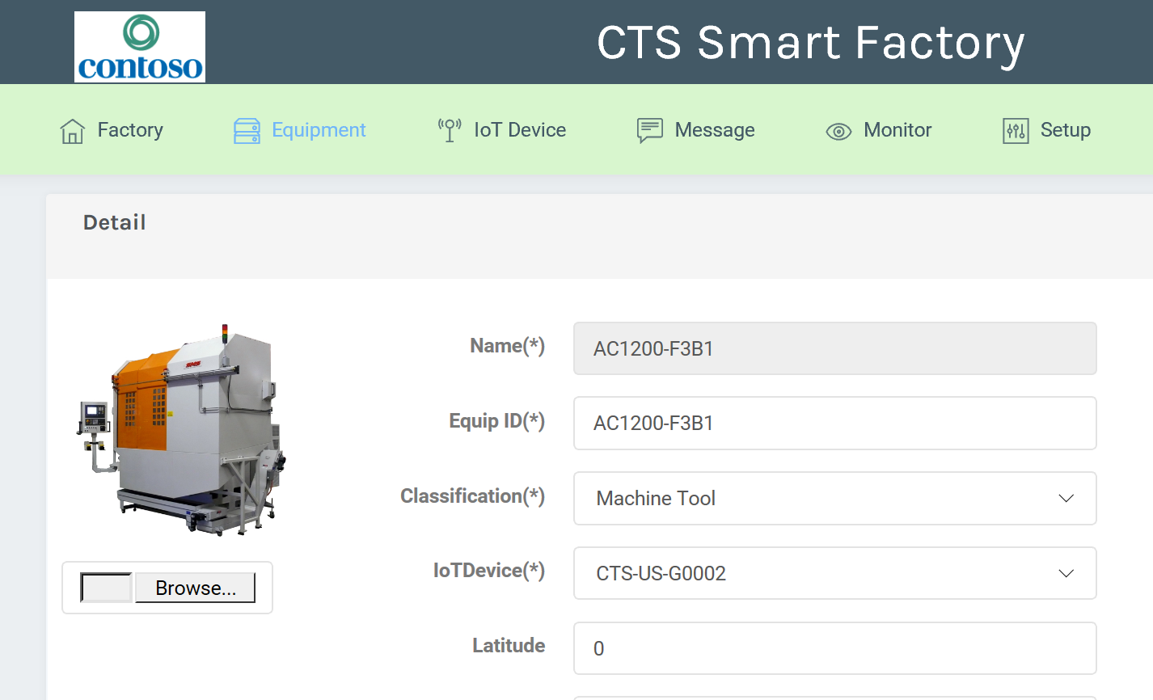
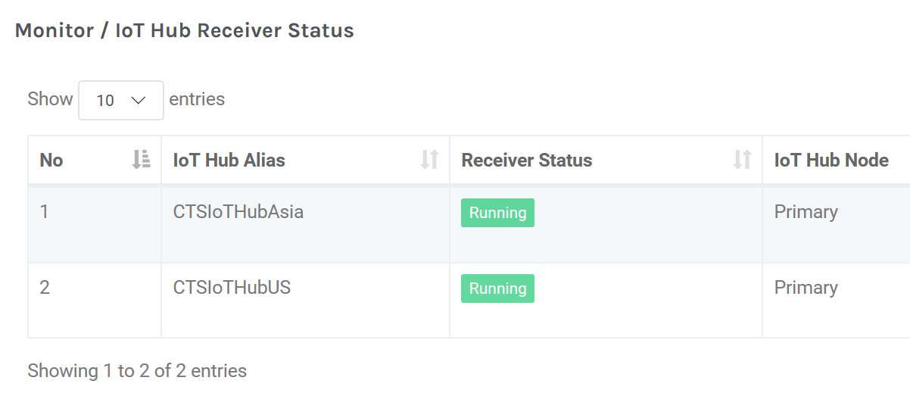
SuperAdmin / Admin Console
Super Admin Console
Super Admin creates Enterprise Account and Admin User.
Backend provisioning task:
Database, storage, default role with permission …
Company A
Company B
Company C
Admin Console
Enterprise Admin User login on Admin Console.
Admin User:
Manage role, permission, user accounts
Setup factories, equipment, IoT Gateway, Message Catalog, Device Configuration, Remote Monitoring…

Slide 18

Data Ingestion Strategy
Each Company uses dedicated IoT Hub(s) for message ingestion.
Each IoT Hub can be adjusted to fit Company message volume when growing. This will be done by IoT Hub, and not directly in the toolkit.
Company A
Company B
Company C

Slide 19
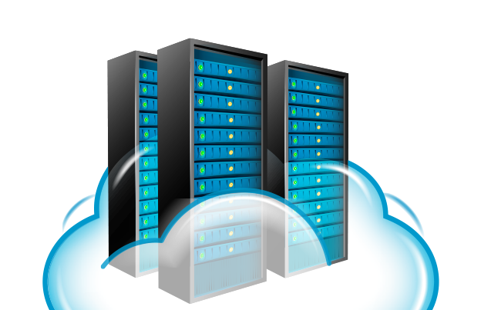

Data Storage Strategy
Secured multi-tenant database (NoSQL) with economy model for all customers.
Configure dedicated database (NoSQL) for the customer, who intent to have it.
Migrate data from multi-tenant database to dedicate database. (*)
Store/synch data back to On-Premise database. (*)
Multi-tenant Database
Dedicated Database
Enterprise A
Enterprise B
Enterprise C
(*) Not Ready Yet

Slide 20
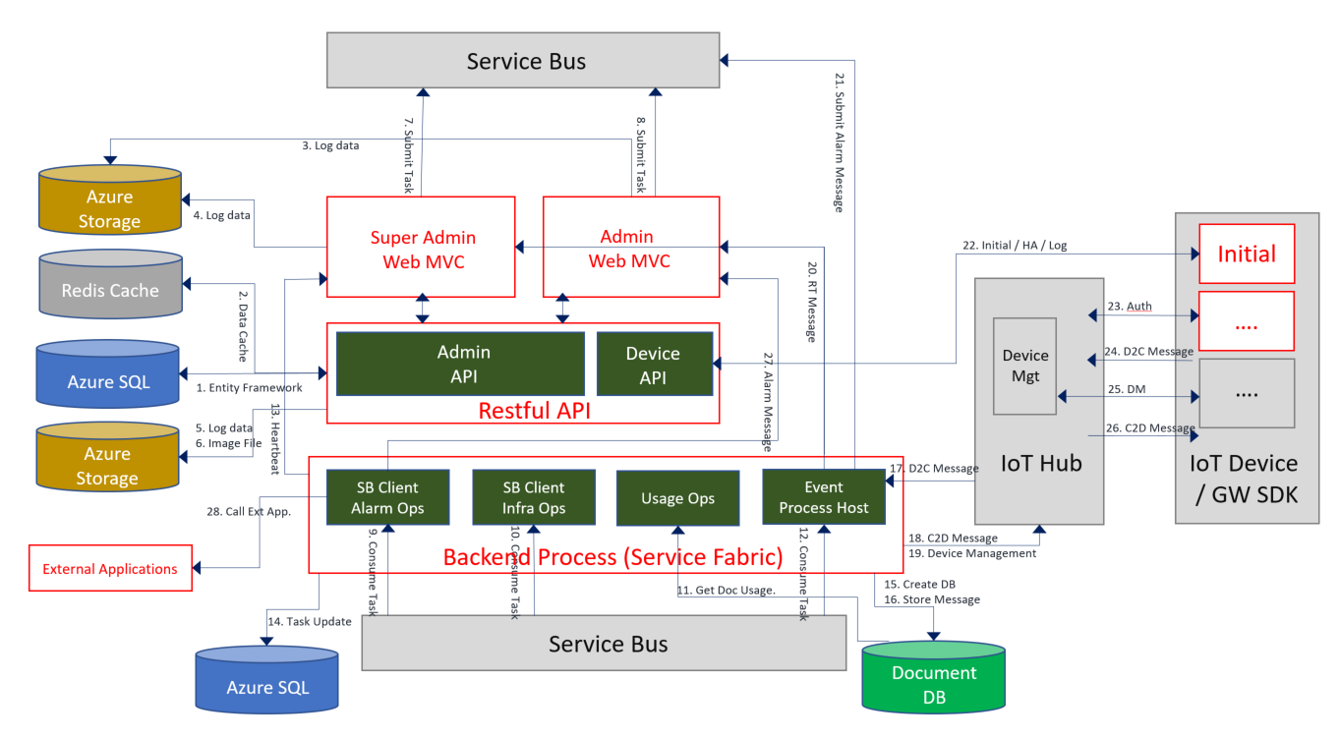
Architecture

Slide 21
Onboarding Client’s Profiles
Company Name
Company Short Name
HQ Address
HQ Latitude
HQ Longitude
Website
Contact Name
Contact Phone
Contact Email
Culture Info
Logo
Company Profile
Email
First Time Password
Employee Number
First Name
Last Name
Language Preference
Photo (PNG 512X512)
Administrator Profile

Slide 22
Agenda
Industry 4.0 and Factory 09:30 ~ 09:45
Core Concept 09:45 ~ 10:00
Connected Device Studio (A) 10:00 ~ 11:30
Login and User Interface (break 10 min)
Basic Management
Connected Device Studio (B) 11:30 ~ 12:20
Device SDK and HOL
Connected Device Studio (C) 13:30 ~ 16:30
Dashboard and Widget
Alarm and Action (break 20 min)
Operation

Slide 23
Web Admin Console: admin.iot-cds.net
Login ID: [Your Email]
Password: 12345

Slide 24
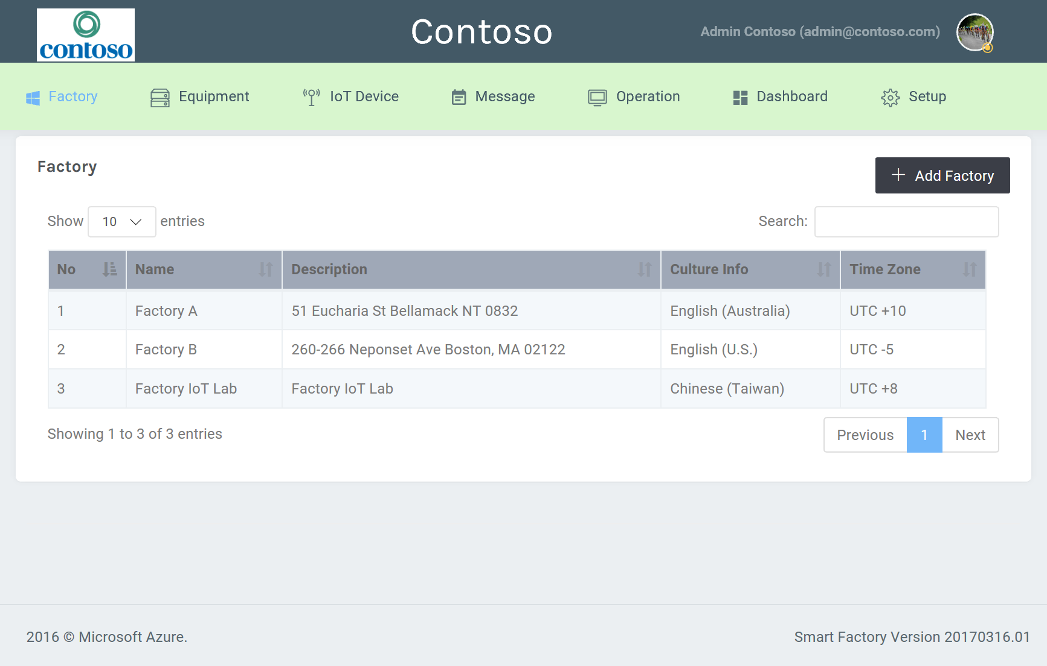
User Interface for All Tenants Factories

Slide 25
Management Flow
A1
A2
A3
User & Role
User Group
Permission
Employee
B1
B3
B5
Factory
Equipment
SF Device
SDK
Remote
Monitoring
B2
B4
B6
B7
Widget
Catalog
IoT Device
Message
Dashboard

Slide 26
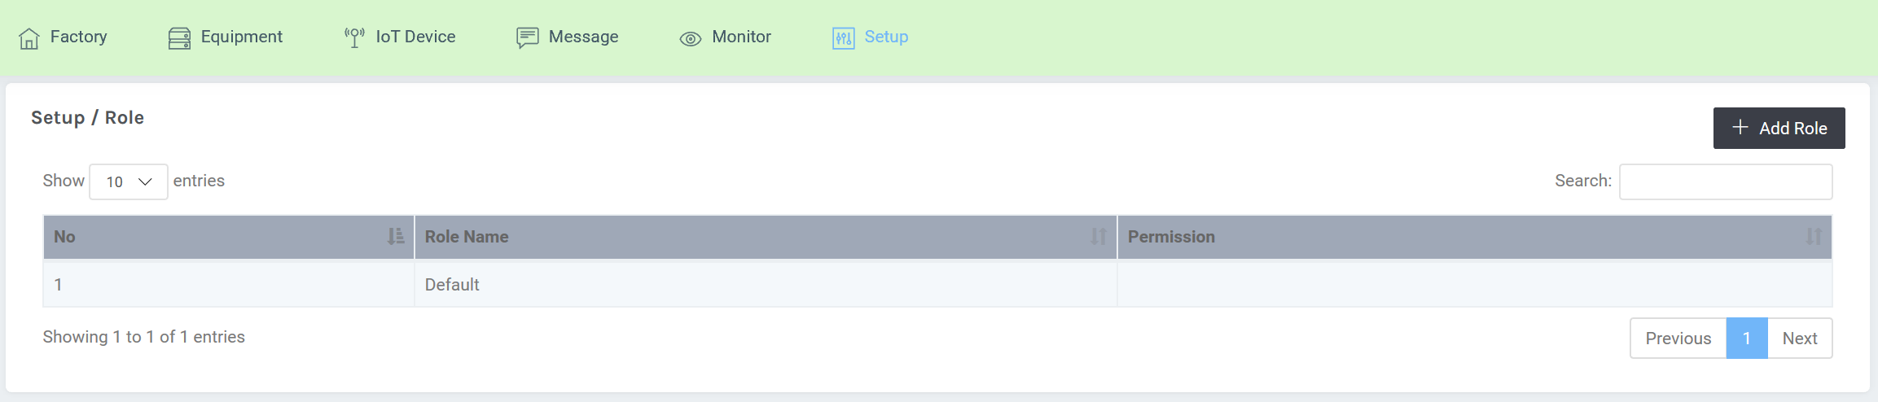
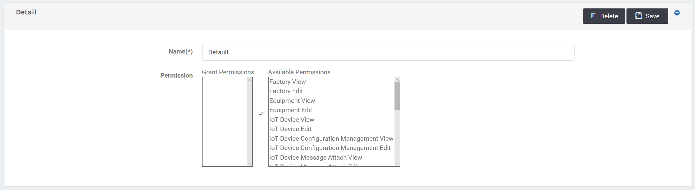
User, User Group & Access Control
A1
User Group
Setup / Role
A2
Permission

Slide 27
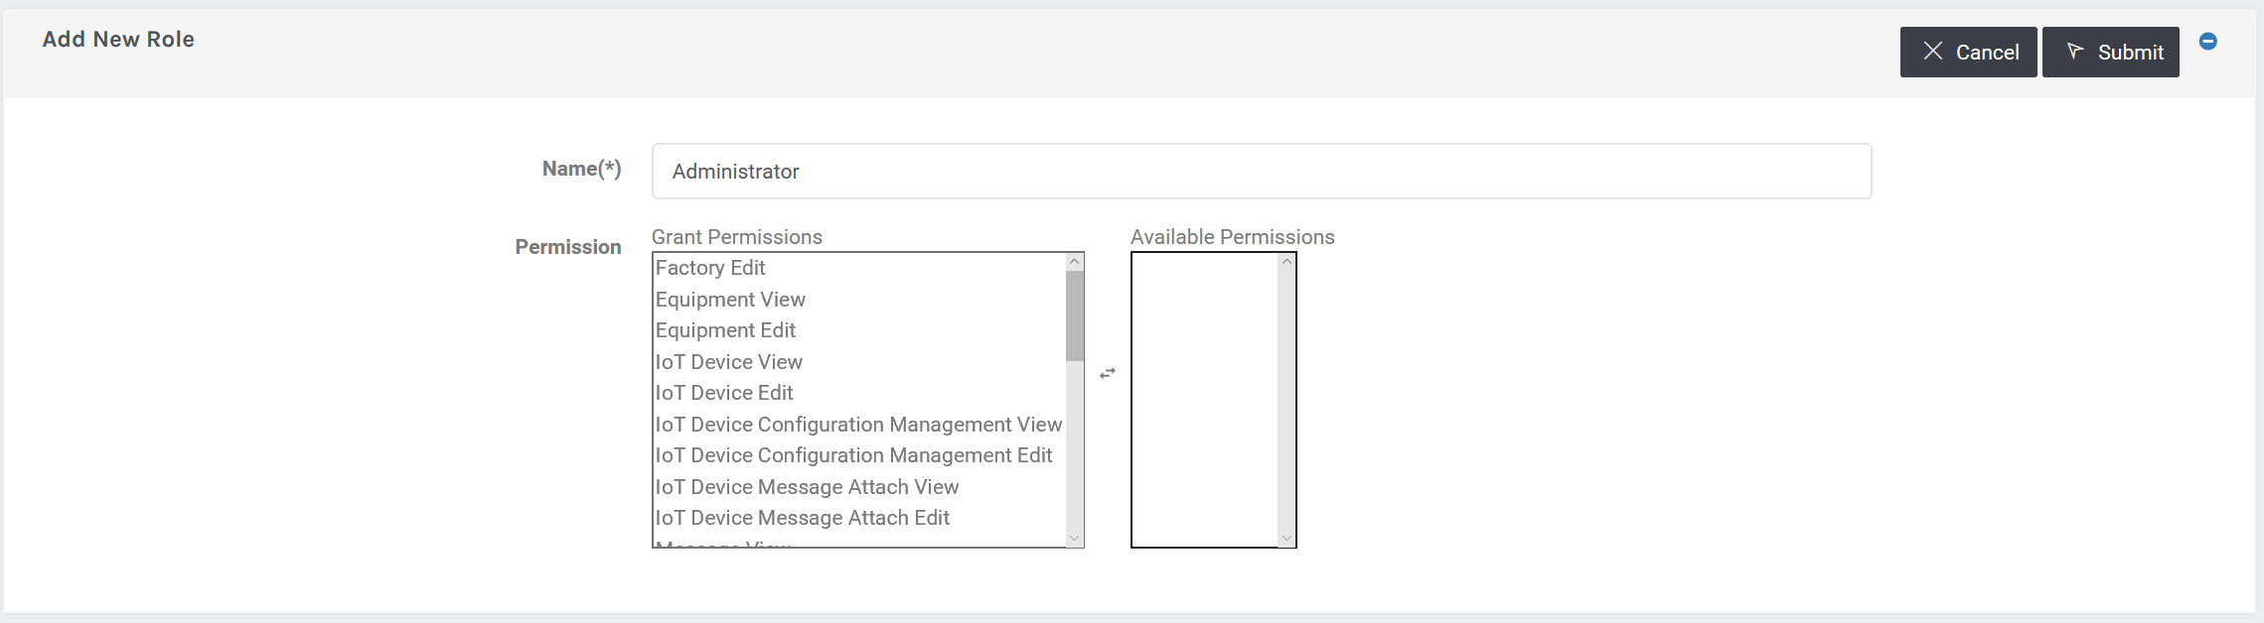
Create New Role
A1
User Group
Setup / Role
A2
1
Permission
2
4
3

Slide 28
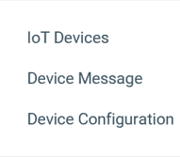
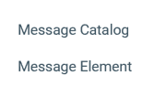
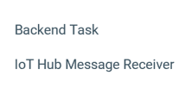
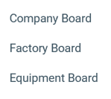
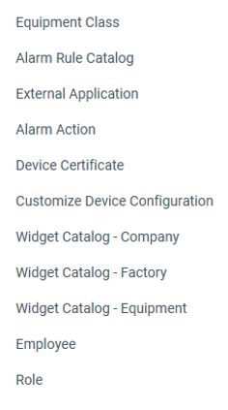
Permissions
A2
Permission
All items are individual to be grant into Role
Factory, Equipment, IoT Device and Message have View and Edit permission. Technically, Edit permission requires View exists.
Each items under Monitor and Setup are full pack grant.

Slide 29
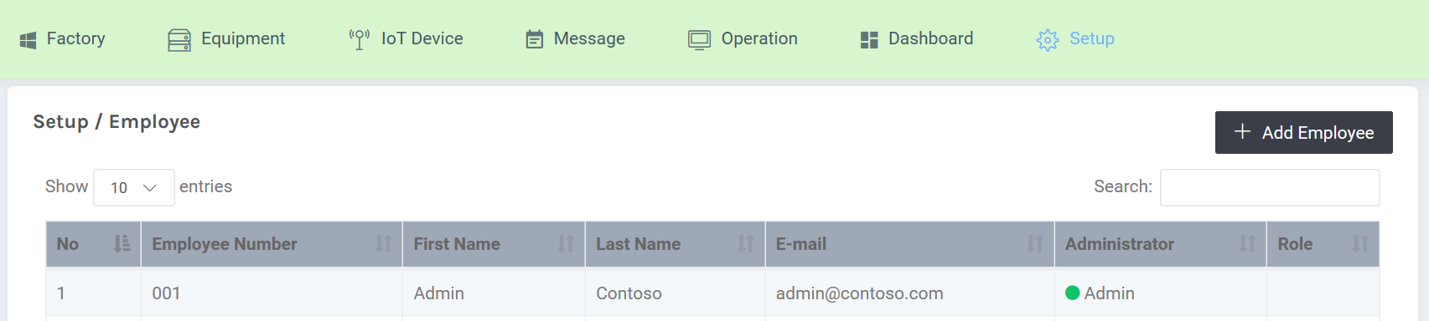
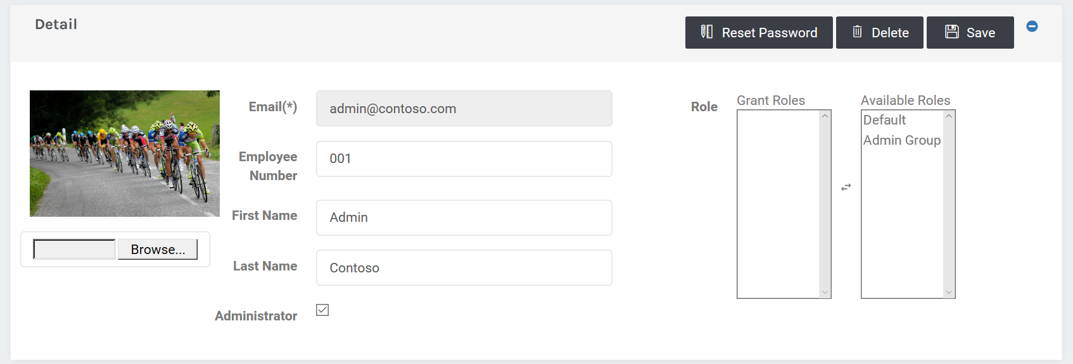
Employee
A3
Employee
Setup / Employee
Overwrite

Slide 30
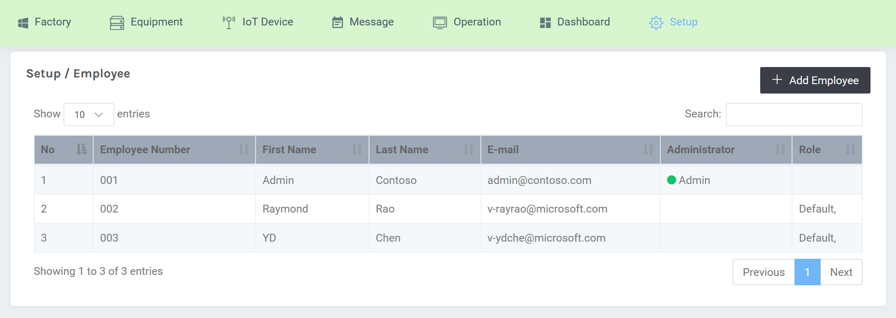
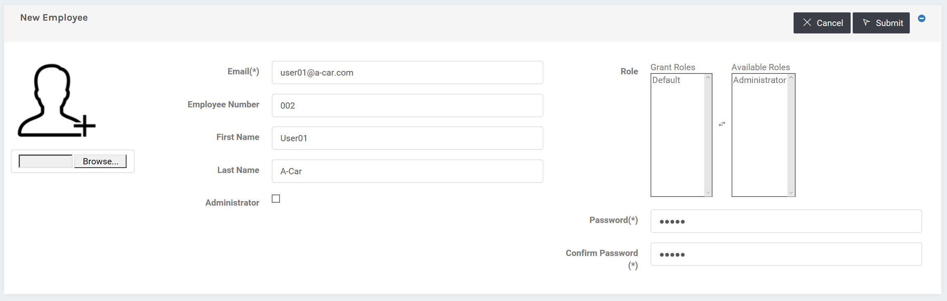
Create New Employee
A3
Employee
Setup / Employee
1
5
3
2
4

Slide 31
Management Flow
A1
A2
A3
User & Role
User Group
Permission
Employee
B1
B3
B5
Factory
Equipment
SF Device
SDK
Remote
Monitoring
B2
B4
B6
B7
Widget
Catalog
IoT Device
Message
Dashboard

Slide 32
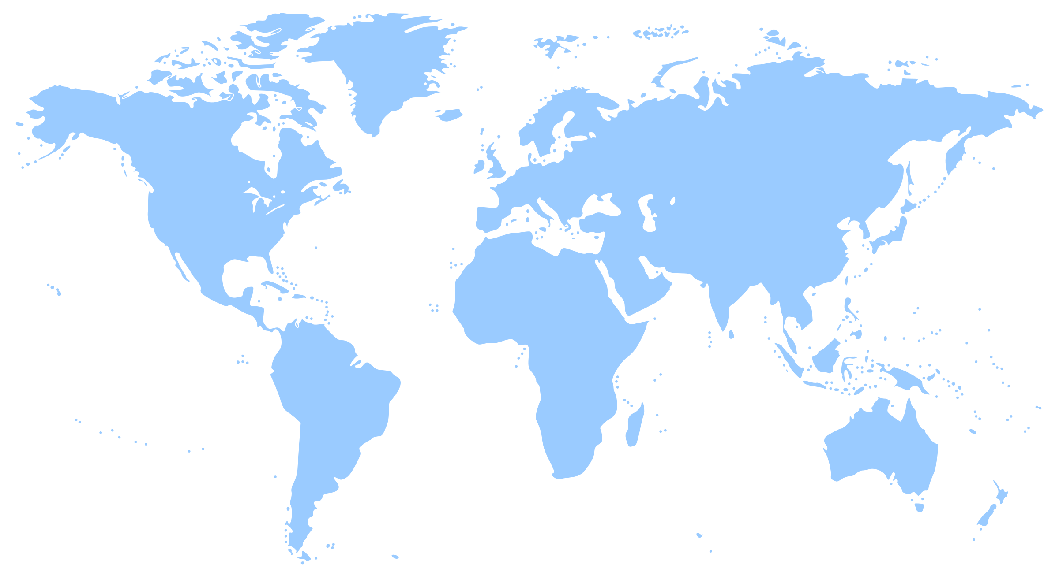

Geographically Distinct Factories
Tips
Each factories should connect to datacenter as closer as possible.

Slide 33
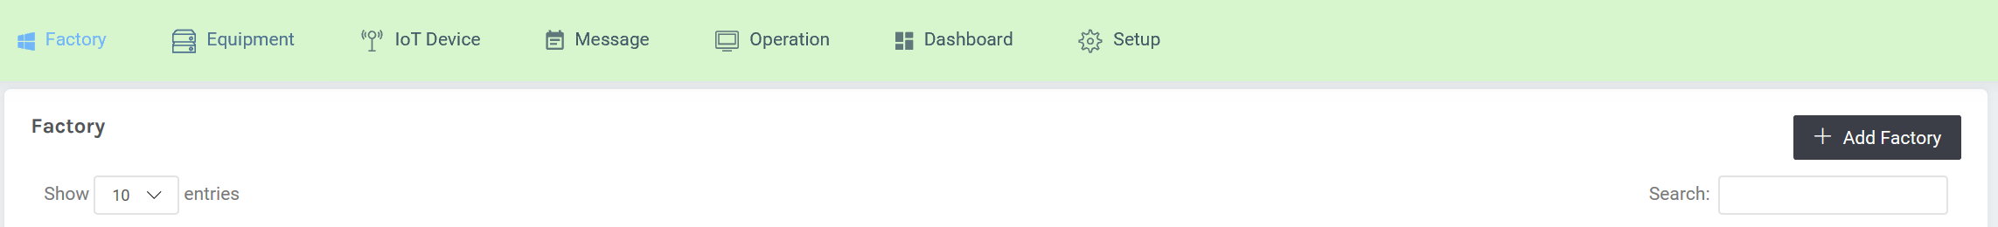
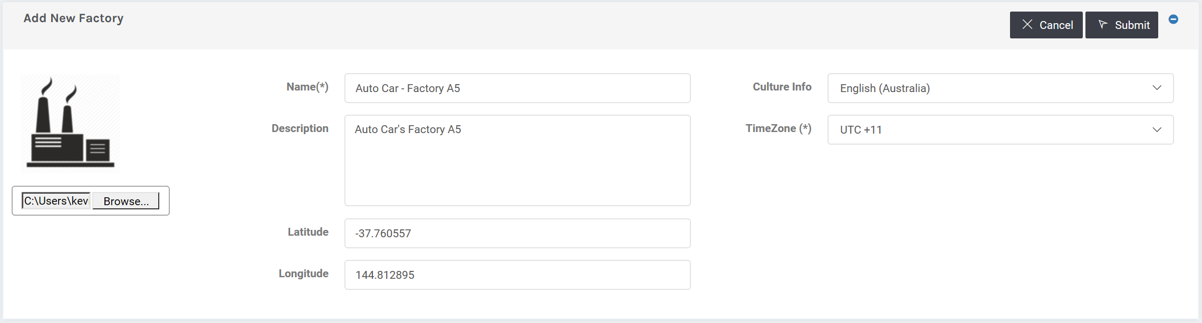
Define Factory
B1
Factory
Factory
1
4
Internalization
3
2
Map Chart

Slide 34
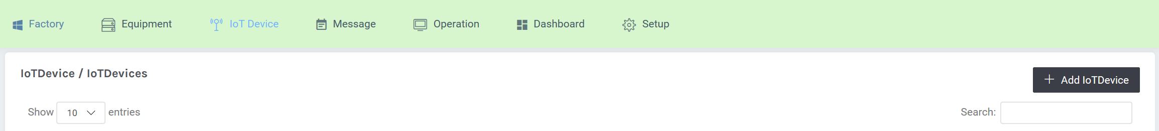
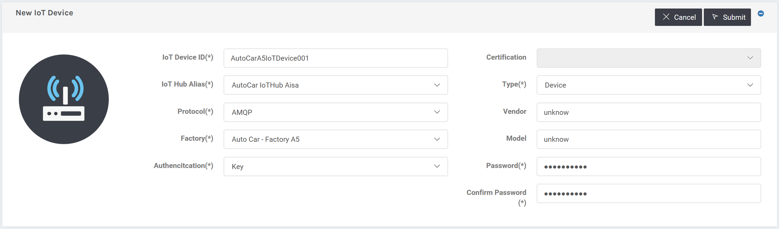
Create IoT Device
B2
IoT Device
IoT Device / IoT Devices
1
2
4
3

Slide 35
Management Flow
A1
A2
A3
User & Role
User Group
Permission
Employee
B1
B3
B5
Factory
Equipment
SF Device
SDK
Remote
Monitoring
B2
B4
B6
B7
Widget
Catalog
IoT Device
Message
Dashboard

Slide 36

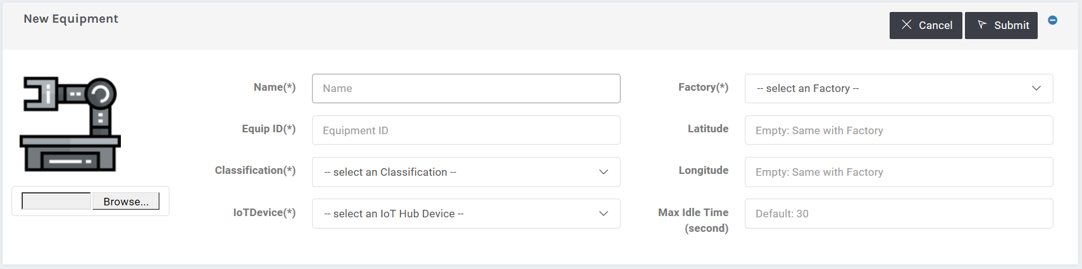
Define Equipment
B3
Equipment
Equipment
1
6
3
4
2
5

Slide 37
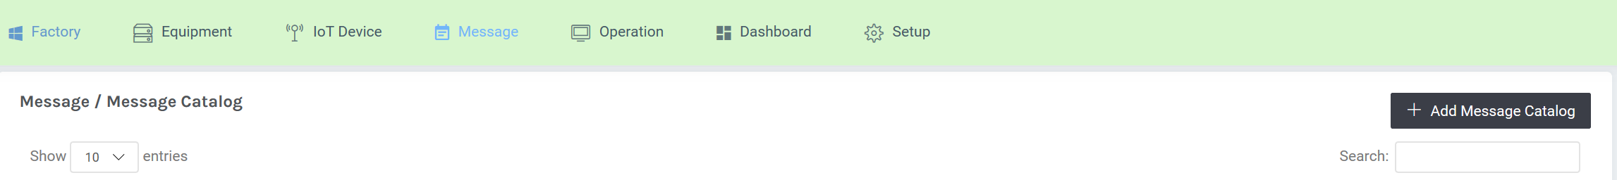
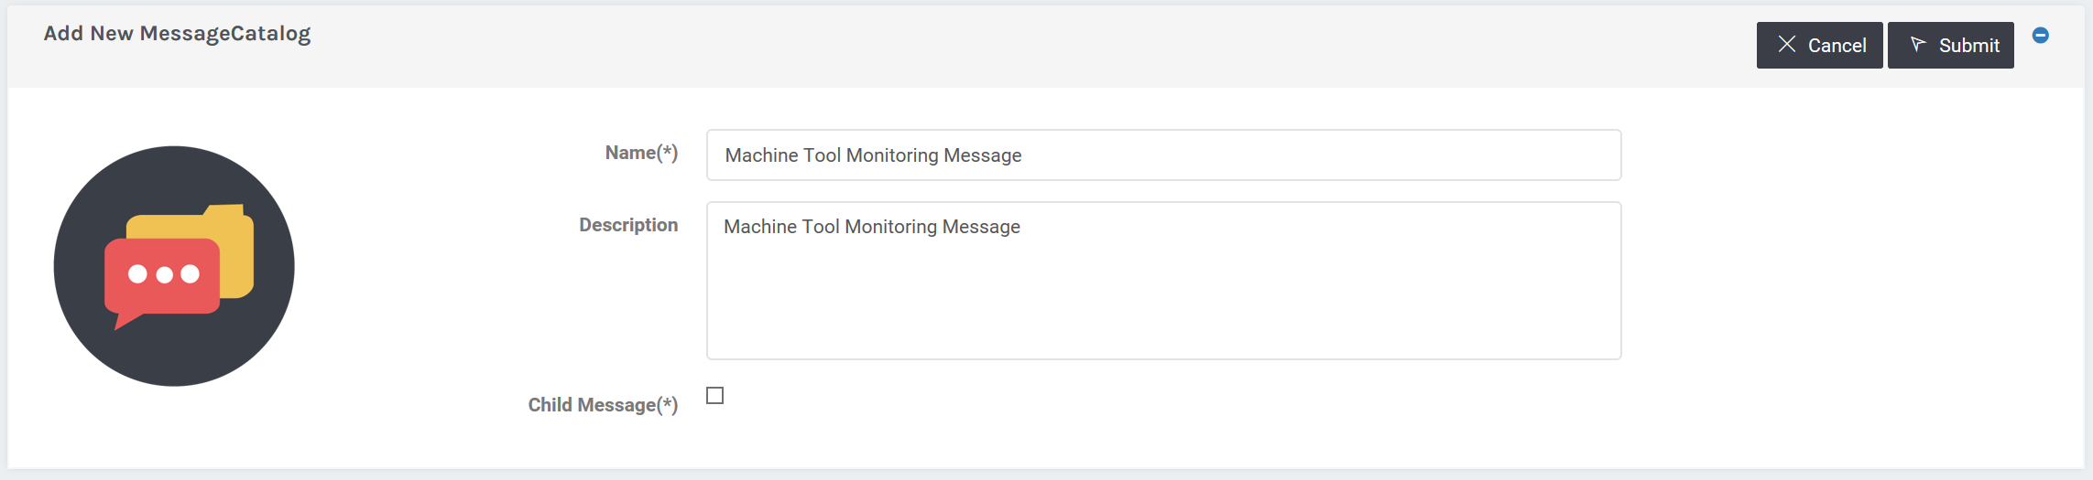
Define Message Schema for Equipment
B4
Message
Message / Message Catalog

Slide 38


Master Message vs. Child Message
Master Message
For External Interface : Send from Device; Widget; Alarm Rule;
Allow Element Type: string, numeric, bool, datetime, message, attach file
Child Message
Support Master message to reduce input effort for duplicate message element.
Allow Element Type: string, numeric, bool, datetime, attach file

Slide 39
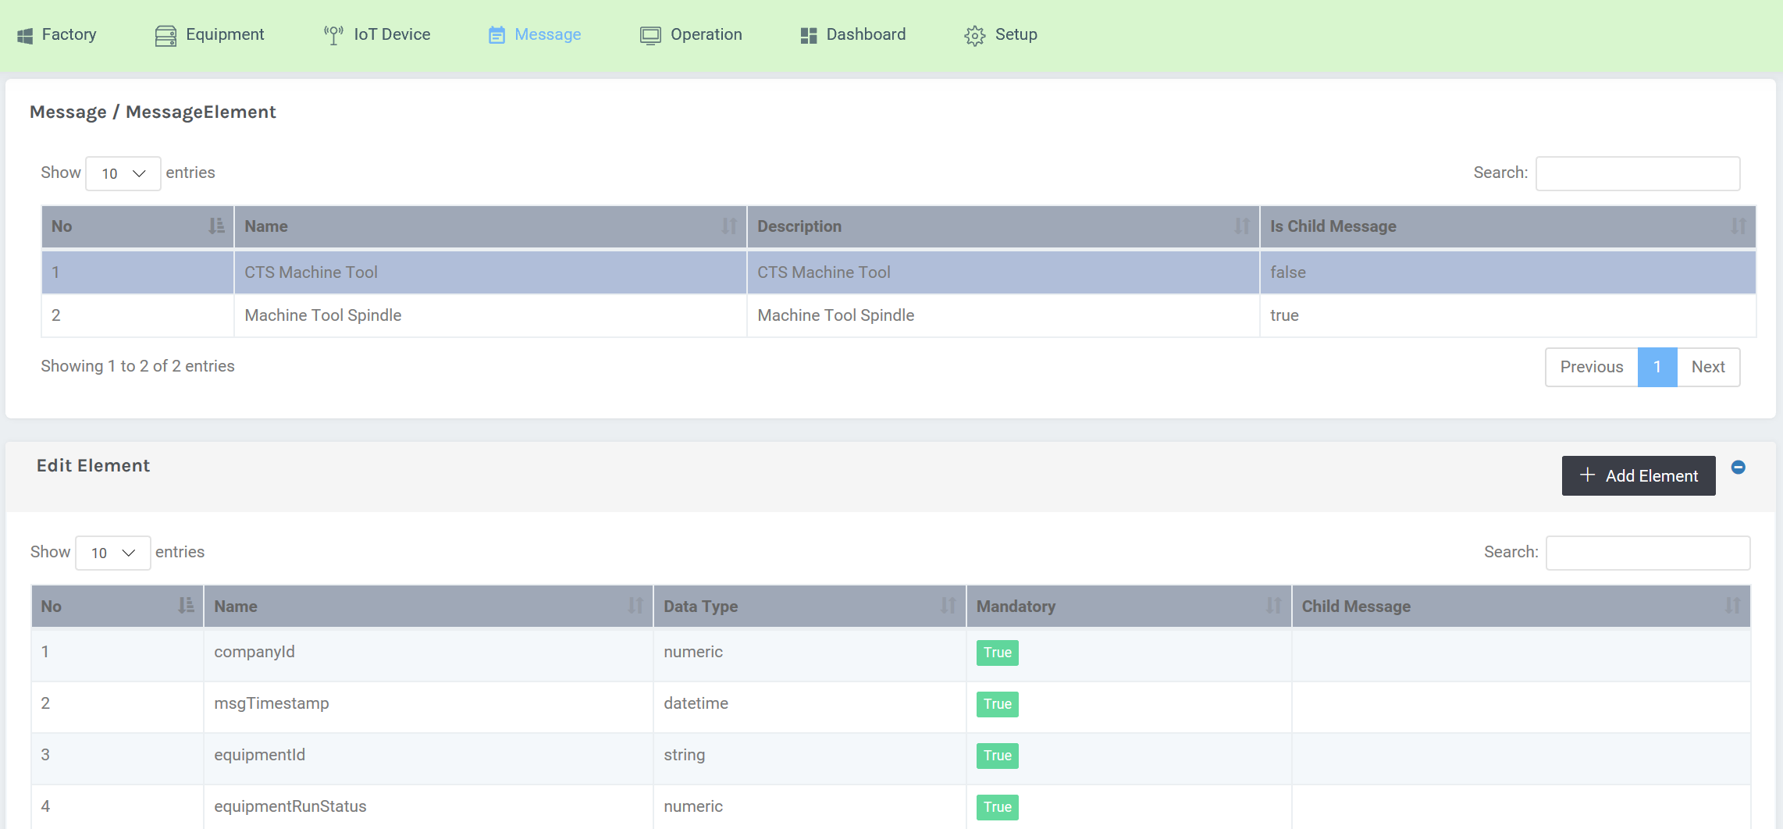
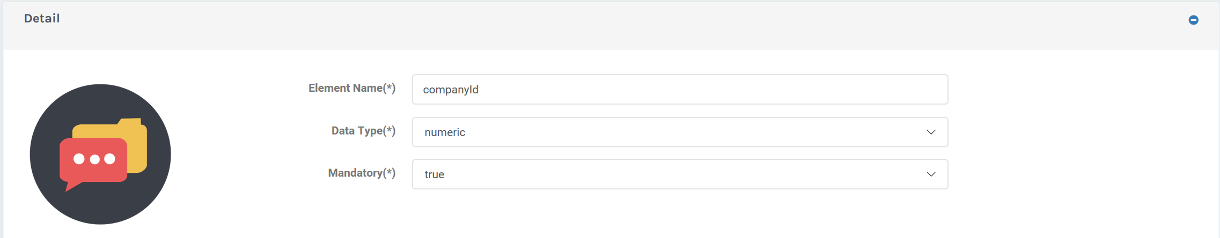
Default Message Element on Master Message
B4
Message
Message / Message Element

Slide 40
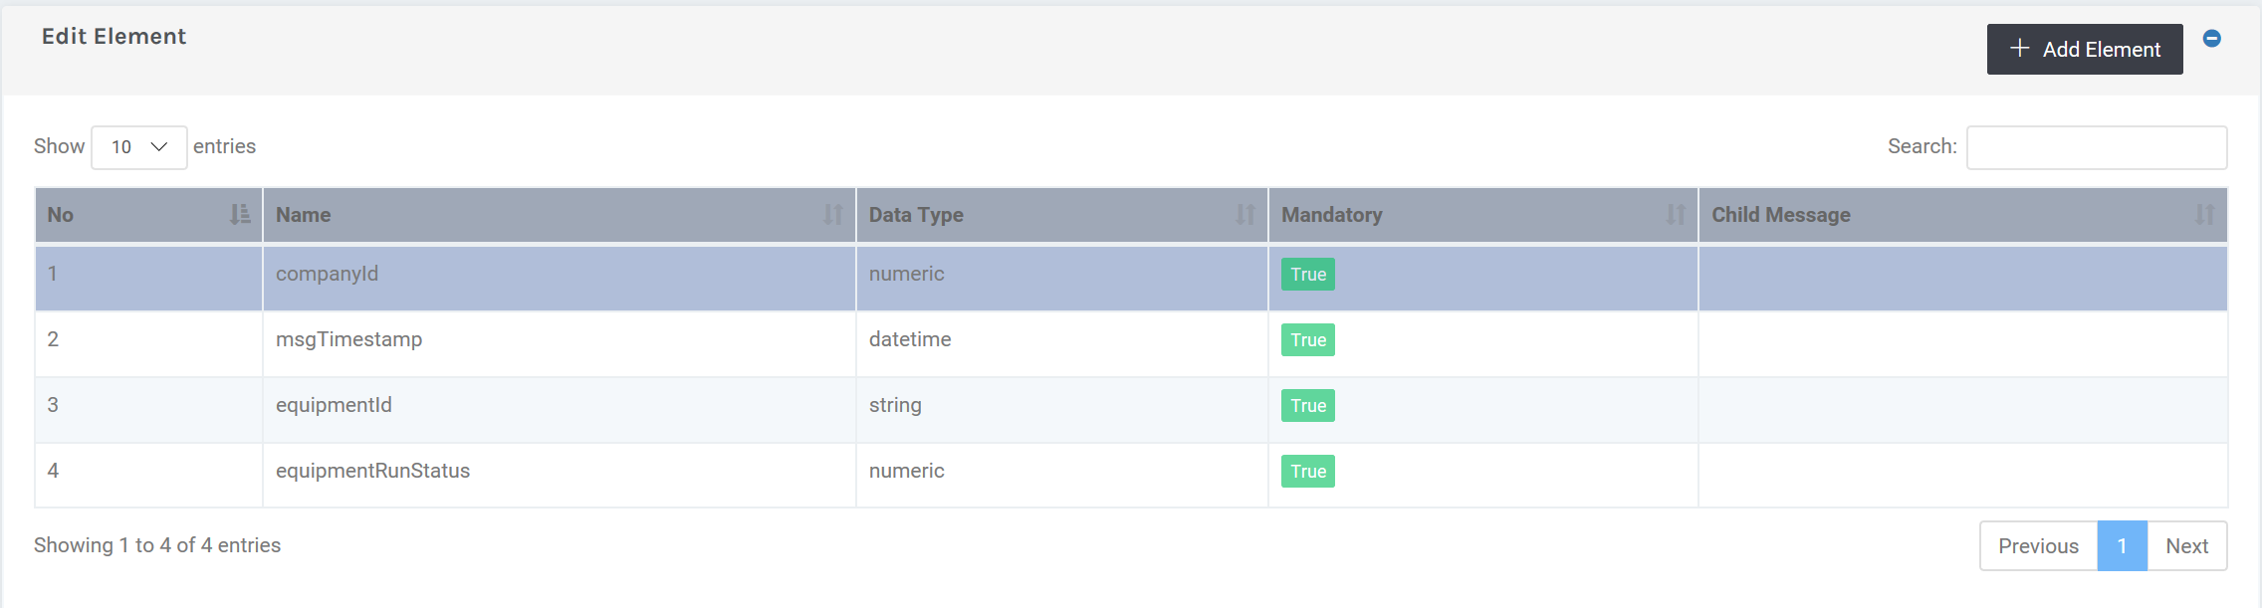
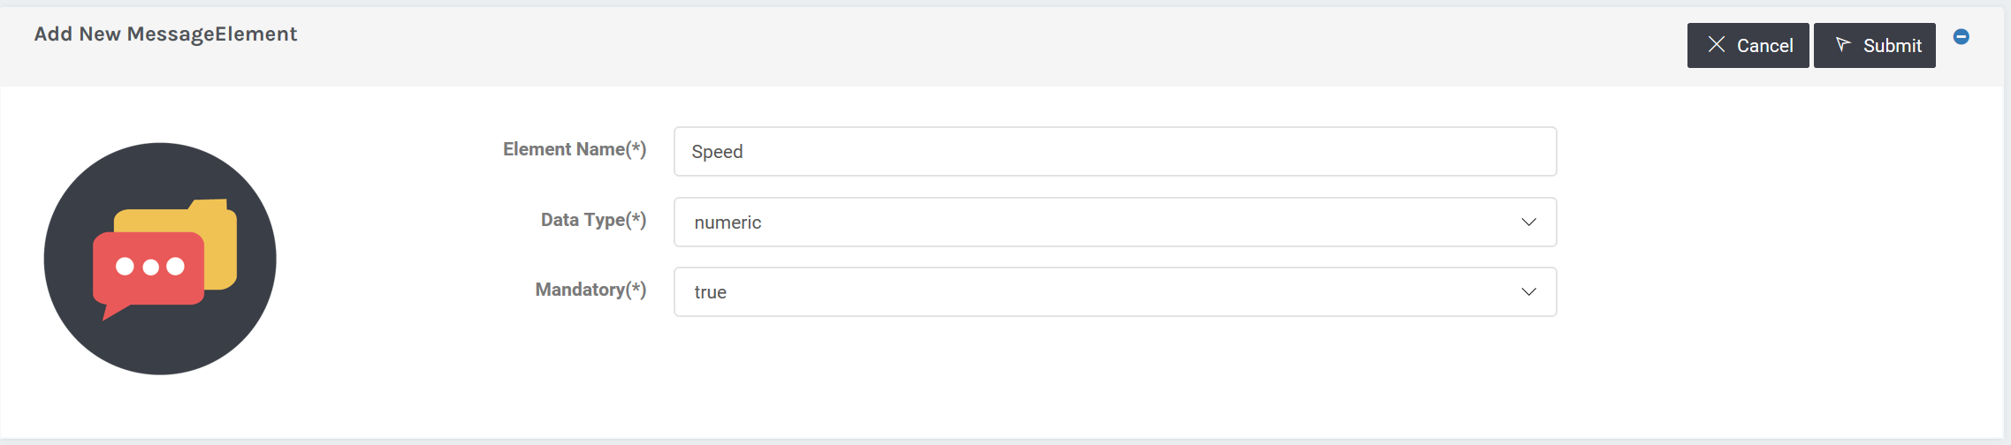
Management Message Element
B4
Message
Message / Message Element
1
3
2
Tips
Message sent from device must contain this field when it is set to ‘true’

Slide 41
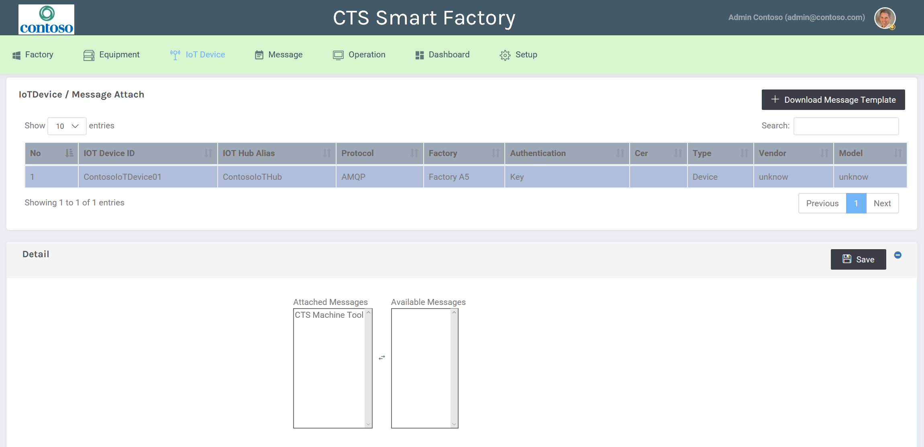
Assign Messages to IoT Device
B4
Message
IoT Device / Device Message
1
3
2
Tips
One IoT Device can be assigned with multiple messages.

Slide 42
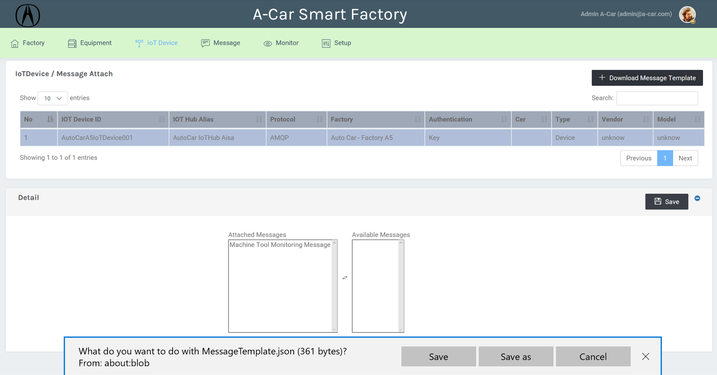
Download Message Template
B4
Message
IoT Device / Device Message
2
1
3

Slide 43
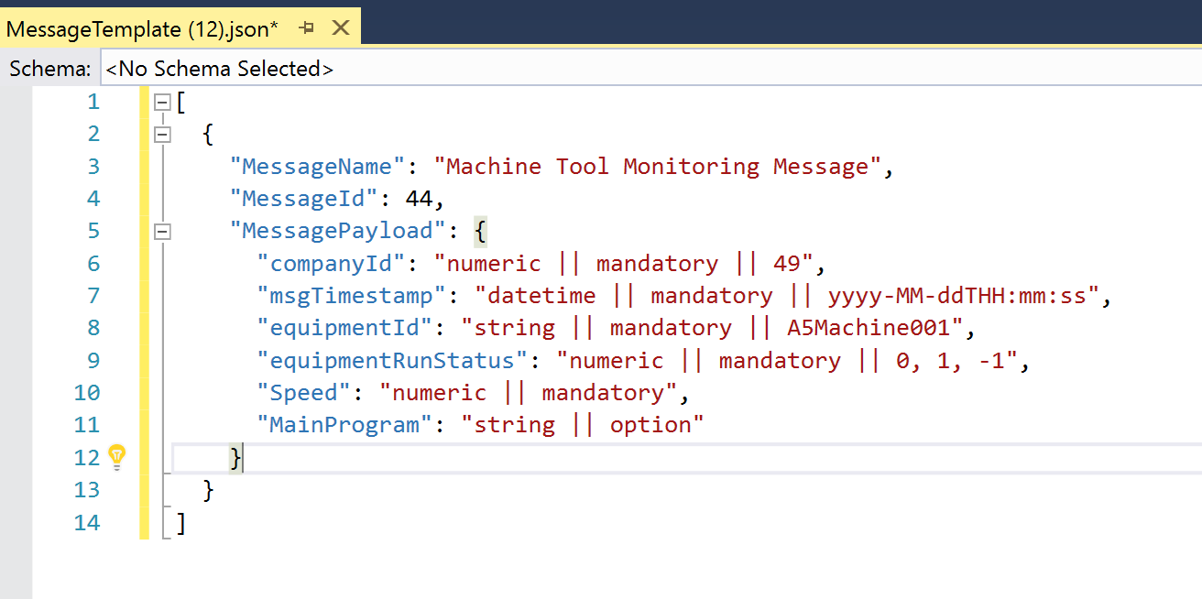
Message Template
B4
Message
IoT Device / Device Message
Put MessageId and CompanyId into device message.
Follow data type and format (such datetime)
Mandatory field must come with value.
RunStatus value:
-1 : stop
0 : idle
1 : start

Slide 44
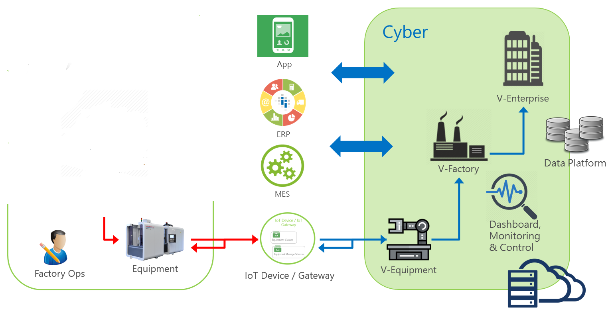
Push Equipment Message to your CPS
1. Download SDK
2. Push Data to CPS

Slide 45
Agenda
Industry 4.0 and Factory 09:30 ~ 09:45
Core Concept 09:45 ~ 10:00
Connected Device Studio (A) 10:00 ~ 11:30
Login and User Interface (break 10 min)
Basic Management
Connected Device Studio (B) 11:30 ~ 12:20
Device SDK and HOL
Connected Device Studio (C) 13:30 ~ 16:30
Dashboard and Widget
Alarm and Action (break 20 min)
Operation

Slide 46


Connected Device Studio Device SDK and HOL
Unzip and Load MachineEmulator
Get CDStudio SDK
Download Message Template
Review and Update App.config
Modify Code
Build and Run it
C# SDK
Node.js SDK

Slide 47
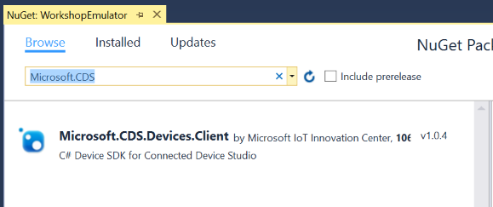
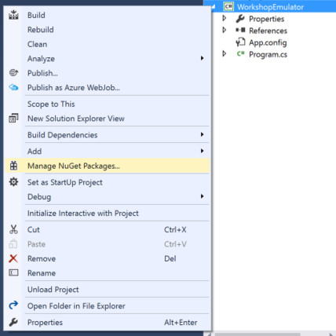
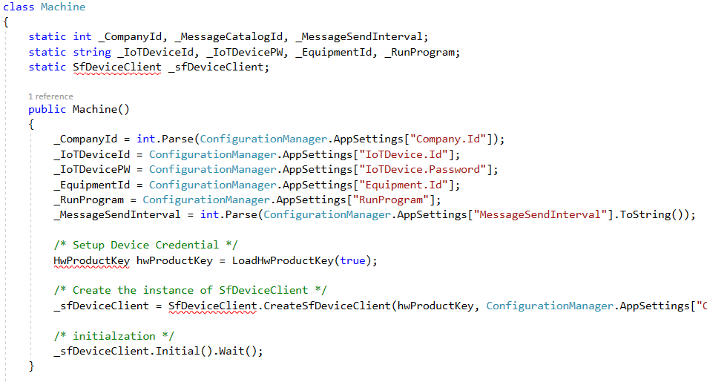
2. Get Connected Device Studio SDK
1
2
3

Slide 48

3. Download Message Template

Slide 49

4. Review and Update App.config
Replace Keys’ Value at here
Company.Id: Copy from Message Template file
Equipment.Id: Copy from Message Template file
IoTDevice.Id, IoTDevice.Password: Copy from Admin Console.

Slide 50


5. Review Code
1
2

Slide 51


5. Modify Code
1. Change MessageCatalog ID
2. Add Customized Fields at here

Slide 52


6. Build and Run it

Slide 53
Agenda
Industry 4.0 and Smart Factory 09:00 ~ 09:15
Core Concept 09:15 ~ 09:30
Smart Factory Toolkit (A) 09:30 ~ 11:00
Login and User Interface
Basic Management
Smart Factory Toolkit (B) 11:20 ~ 12:00
Device SDK and HOL
Smart Factory Toolkit (C) 13:30 ~ 16:00
Dashboard and Widget
Operation
Alarm and Action

Slide 54
Management Flow
A1
A2
A3
User & Role
User Group
Permission
Employee
B1
B3
B5
Factory
Equipment
SF Device
SDK
Remote
Monitoring
B2
B4
B6
B7
Widget
Catalog
IoT Device
Message
Dashboard

Slide 55



Dashboards
B7
Dashboard
Company Dashboard
Factories Dashboard
Equipment Dashboard

Slide 56
Company Dashboards
B7
Dashboard
Real-Time
The board be created automatically at the company provisioning flow.
All company-level widgets be assigned into the board as well.
There are 8 company-level widgets available now.
What you need/can to do are:
Define [Title] on each Widgets
Define Size and Location on each Widgets
Drop any Widgets from board if you feel non-sense
Add any Widgets back to board if you feel good to have
Company Dashboard

Slide 57

Company Level Widget Catalog
B7
Dashboard
Setup / Widget Catalog – Company
1
2

Slide 58


Company Level Widget Catalog
B7
Dashboard
Setup / Widget Catalog - Company
Change Title on each company level widget catalog.

Slide 59
Show Company Dashboard
B7
Dashboard
Dashboard / Company Board

Slide 60
Factory Dashboards
B7
Dashboard
Real-Time
The board be created automatically when you define a new Factory on Admin Console.
All Factory-level widgets be assigned into the board as well.
There are 9 Factory-level widgets available now.
What you need/can to do are:
Define [Title] on each Widgets
Define Size and Location on each Widgets
Drop any Widgets from board if you feel non-sense
Add any Widgets back to borad if you feel good to have
Factories Dashboard

Slide 61

Setup Up Factory Board
B7
Dashboard
Setup / Widget Catalog – Factory
1
2

Slide 62

Company Level Widget Catalog
B7
Dashboard
Setup / Widget Catalog - Factory
Change Title on each factory level widget catalog.
Video URL support:
HLS Live Streaming
Mpeg-Dash Live Streaming
MP4, Progress Download Video Clip

Slide 63

Factory Dashboard List
B7
Dashboard
Dashboard / Factory Board

Slide 64
Show Factory Dashboard
B7
Dashboard
Dashboard / Factory Board

Slide 65


Equipment Dashboards
B7
Dashboard
Messages
Widget Catalogs
Tips
You should define your own Widget Catalogs by message context and visual widget template.
Equipment Dashboard

Slide 66
Equipment Dashboards
B7
Dashboard
Real-Time
The board be binding on Equipment Class, and you shall define by your own.
There are 14 Equipment-level widgets visual component available now.
What you need/can to do are:
Create your own widgets by business context
Select suitable widgets visual component and binding with message schema
Define [Title] and [meta-data] on each Widgets
Define Size and Location on each Widgets
Equipment Dashboard

Slide 67



Equipment-Level Widget Visual Component
B6
Widget
Catalog
Widget Title
Equipment Photo
Factory Name
Equipment Class
Equipment Name
Lighting Status
Basic Card
Widget Title
X Axis Source Field
Y1, Y2, Y3 Source Fields
Y1, Y2, Y3 Scale Position
Y1, Y2, Y3 Color Codes
Line Chart
Widget Title
X Axis Source Field
Y1, Y2, Y3 Source Fields
Y1, Y2, Y3 Color Codes
Bar Chart

Slide 68


Equipment-Level Widget Visual Component
B6
Widget
Catalog
Widget Title
Value 1,2,3,4 Source Fields
Value 1,2,3,4 Display Name
Value 1,2,3,4 Color Code
Pie Chart
Widget Title
Total Source From
Total Source
Current Number Source
Foreground Color Code
Background Color Code
Percentage Card

Slide 69


Equipment-Level Widget Visual Component
B6
Widget
Catalog
Widget Title
Zoom Level
Lat / Lng (Fixed)
Map Card
Widget Title
Zoom Level
Lat / Lng (Moving)
Location Trace

Slide 70



Equipment-Level Widget Visual Component
B6
Widget
Catalog
Widget Title
Text Source Field
Color Code
Text Card
Widget Title
Text 1,2,3,4 Source Fields
Text 1,2,3,4 Display Name
Ball 1,2,3,4 Color Code
Text List
Widget Title
HTML Source From
Input Text
Message Field
HTML Content

Slide 71


Equipment-Level Widget Visual Component
B6
Widget
Catalog
Widget Title
Good Units
Ideal Cycle Time
Planned Production Time
Threads hold
Simple OEE
Widget Title
Run / Planned Time
Produced / Expt. Units
Good / Total Units
Threads Hold
Preferred OEE

Slide 72


Equipment-Level Widget Visual Component
B6
Widget
Catalog
Widget Title
Alarm Text Color
Alarm BG Color Code
Alarm Card
Widget Title
Alarm Data Range
Alarm Records

Slide 73


Create Your Widget Catalog
B6
Widget
Catalog
Setup / Widget Catalog - Equipment
1
2
3

Slide 74


Edit Widget Context
B6
Widget
Catalog
Setup / Widget Catalog - Equipment
1
For Line Chart, X and Y1 are mandatory fields.
It is your responsibility to pick up correct data type for each fields. Such as numeric fields on Y axis.
3
2

Slide 75

Widget Catalog
B6
Widget
Catalog
Setup / Widget Catalog - Equipment
As result, you shall have bunch of list Widget Catalogs on the pool.

Slide 76


Equipment Dashboards Example
B7
Dashboard
Dashboard / Equipment Board
Add Equipment Widget by your self
Adjust location, size, layout and save the board.

Slide 77
Alarm and Action
C1
Define
Alarms
C3
Alarm and Action
Assign
Actions
C2
External
Applications

Slide 78


Create Alarm Rule Catalog
C1
Define
Alarms
Setup / Alarm Rule Catalog
1
5
3
4
Tips
2
To avoid too much alarms be trigger at very short period, you can set up ‘Aggregate Alarm in Sec’.

Slide 79


Define Rule Sets
C1
Define
Alarms
Setup / Alarm Rule Catalog
1
2
5
3
4

Slide 80


Create External Application – Alarm on Dashboard
C2
External
Applications
Setup / External Application
1
3
2
Tips
There shall be only one Dashboard Alarm on your setting.

Slide 81


Show Alarm on Dashboard
C3
Assign
Actions
Setup / Alarm Action
1
3
2

Slide 82
Display Alarm on Dashboard
Trouble Shooting..
Create Alarm Rule Completed
Alarm Rule set as Active
Equipment message fit Alarm Rule
Display Alarm on Dashboard Action created.
Action be assigned to Alarm Rules
You have to restart IoT Hub Receiver after update any Alarm and Action

Slide 83


Alarm
Define Alarm by Your Own
Alarm from Equipment/Machine
Alarm created by conditions & rules
Aggregated multiple same alarms to one
Enable/Disable Alarm on demand
From Equipment Directly
Field (AlarmMessage) != NULL
Field (AlarmMessage) = Over Speed
By Rule Set you defined on Toolkit
Filed (equipmentId) = A123 AND
Filed (temperature) >100 END

Slide 84




Action
Create Action
Show Alarm on Dashboard
M2M communication
External Application (SMS, Email, ERP…)
Standard Interface / Authentication
App
ERP
MES

Slide 85
Link Actions to each Alarm
Over Heat
Display on Dashboard
Over Run
Slow Down Machine
Over Speed
Send SMS to Admin
Invoke SAP Process
Connected Device Studio allow each companies have its’ own Alarm logics, action context and binding them together on demand.

Slide 86
Alarm and Action (Advanced)
C1
Define
Alarms
C3
Alarm and Action
Assign
Actions
C2
External
Applications

Slide 87

Create External Application – Command to IoT Device
Setup / External Application
C2
External
Applications
1
5
4
2
3
Tips
Output Template allow you to define custom out-going message to IoT Device. It often to be a cloud to device command.

Slide 88



External Application – Output Template
C2
External
Applications
Equipment Message
Send out customized data to external applications.
Must be {JSON} format
@.....@ will be replaced with schema value
Alarm Name
Alarm Desc
Any Text
{“Command”:”Stop”}

Slide 89
Cloud 2 Device Command
Cloud 2 Device Command

Slide 90

Create External Application – Restful API
C2
External
Applications
Setup / External Application
1
8
6
7
2
Tips
3
Output Template allow you to define custom out-going message to other application.
4
5

Slide 91
Create External Application – Send Email
C2
External
Applications
Target:
External
Service URL:
http://externalapplicationagent.azurewebsites.net/api/Email/PostEmail
Method:
POST x-www-form-urlencoded
Auth Type:
Basic Auth
Auth ID:
kevin
Auth PW:
12345
Output Template:
{
"senderEmail":“xxxxx@abc.com",
“senderName”:“CDS Alarm",
"receverEmail":“administrators@myCompany.com",
"receverName":“Admin Group“
,"subject":"@AlarmRuleCatalogName@",
"plainTextContent":"msgTimestamp:@msgTimestamp@; equipmentId:@equipmentId@“
}

Slide 92
External Application – POST Method
C2
External
Applications
RFC 1738
Content-Type: application/x-www-form-urlencoded
Ex: username=MyName&password=mypassword
x-www-form-urlencoded
RFC 2045
Content-Type: multipart/form-data
Send out each elements by boundary
Multipart/form-data
RFC 4627
Content-Type: application/json
Ex: {“username”:”MyName”, “password”:”mypassword”}
application/json

Slide 93
Device Management
Create your-own device configuration schema
Push new configuration value to devices
Report and present device applied configuration
Device Management
1. Change Message Upload Interval
Connected
Device
Studio
2. Change Run Program & Message
Equipment

Slide 94
Customized Dashboard
Real-Time Telemetry Message and Alarm
Fully tailor-made dashboard (Web / mobile app)
Hosted customized dashboard out-side of CDS
Secure Data
Customized
Dashboard

Slide 95
Operation
Monitor health of backend tasks and running state
IoT Hub (Message Receiver) operation tasks result
IoT Device operation tasks result
Alarm Action tasks result
D1
Backend
Task
D2
Monitoring IoT Hub Message Receiver running state
Allow administrator of client to Restart IoT Hub Message Receiver
IoT Hub
Receiver

Slide 96


Backend Task
D1
Backend
Task
Operation / Backend Task
Tips
Call support if anything fails or does not complete successfully.

Slide 97

Operate IoT Hub Message Receiver
D2
IoT Hub
Receiver
Operate / IoT Hub Message Receiver
When shall Restart IoT Hub Message Receiver ?
Message Schema Change
Alarm Rule Change
Tips
All Dashboards require IoT Hub Receiver to be up and running.

Slide 98


Connected Device Studio Partner Program
Free of Charge.
Transfer the Toolkit to partners who are interested and qualified.
MIT License.
NDA.
Joined Marketing and Promotion.
Business Alignment.

Slide 99
Connected Device Studio Workshop
Slide Deck: https://aka.ms/cds-deck
WiFi
SSID: IoTWorkshopTW / IoTLab
Key: iotlab520

